Slide 1
Face and Object Detection Using Python OpenCV (Drishti)
Under Guidance of:
Dr. Abeg Kumar Jaiswal
Presented by:
Biswamit Biswal
21CSC018
Rajeev Tirkey
21CSC036

Slide 2
Acknowledgement
We would like to express our sincere gratitude to all those who have contributed to the successful completion of this project on face and object detection using Python OpenCV. Their support, guidance, and expertise have been invaluable throughout this journey. First and foremost, we extend our deepest appreciation to Dr. Abeg Jaiswal, whose unwavering encouragement, insightful feedback, and expert guidance were instrumental in shaping this project and pushing us towards excellence. We are grateful to the developers of OpenCV, whose groundbreaking work in computer vision has provided us with the powerful tools and libraries necessary for implementing advanced image processing techniques in Python. We would also like to acknowledge the contributions of the broader Python and computer vision communities. The wealth of knowledge, resources, and open-source projects shared by these communities has been a constant source of inspiration and learning. Last but not least, we express our heartfelt appreciation to our families and friends for their unwavering support, understanding, and encouragement during the ups and downs of this project. Together, the collective efforts of all individuals mentioned above have played a pivotal role in the realization of this project, and for that, we are truly grateful.

Slide 3
Abstract
In an era dominated by visual information, the ability to effectively analyze and interpret images is of paramount importance. This project focuses on leveraging the power of computer vision techniques, specifically face and object detection, to address real-world challenges in various domains such as security, surveillance, and human-computer interaction.
Using the OpenCV library in Python, our project implements advanced algorithms for detecting and recognizing faces and objects in images and video streams. We employ state-of-the-art techniques including Haar cascades, deep learning-based approaches such as convolutional neural networks (CNNs), and feature-based matching methods to achieve robust and accurate detection results.
The project provides a user-friendly interface that allows users to input images or video streams and seamlessly perform face and object detection tasks in real-time. Additionally, we integrate features for visualizing detection results, such as bounding boxes and labels, enhancing the interpretability of the detected objects.
Key features of our project include:
Implementation of face detection algorithms capable of accurately identifying faces in images and video streams under various lighting conditions, orientations, and occlusions.
Object detection capabilities enabling the detection and localization of a wide range of objects, including but not limited to vehicles, animals, and everyday items.
Integration of real-time processing capabilities, allowing for efficient and responsive detection performance even on resource-constrained devices.
Customizable parameters and options for fine-tuning detection performance based on specific application requirements.
Cross-platform compatibility, enabling the deployment of the project on diverse computing environments.
Through extensive experimentation and evaluation, we demonstrate the effectiveness and versatility of our face and object detection system across diverse datasets and real-world scenarios. The project not only serves as a valuable tool for researchers and practitioners in the field of computer vision but also opens up avenues for innovative applications in areas such as autonomous systems, augmented reality, and smart surveillance.
Overall, our project represents a significant step towards democratizing access to advanced computer vision technologies, empowering users to harness the potential of visual data for a wide range of applications.

Slide 4
Contents
Introduction
Objectives
Applications
Implementation
Limitations
Images
Conclusion

Slide 5
INTRODUCTION
Computer Vision is a sub-field of artificial intelligence, that analyzes the image and video-stream and derive some useful information from it.
Purpose:
The purpose of this project to is make a simple user interface that can detect faces and objects.
Python:
Python is a robust and flexible programming language, that has many useful libraries that aid in image processing.
OpenCv ( Open Source Computer Vision Library):
It is a powerful open source library for computer vision and image processing. It provides a wide range of functionalities for tasks such as image manipulation, object detection, face recognition and more.

Slide 6
What is Face Detection?
Face detection is a computer technology that identifies and locates human faces within digital images or video frames. It's a fundamental component of various applications, including facial recognition, security systems, photography, and social media.
Face detection algorithms analyze an input image to determine whether or not there are any human faces present. These algorithms typically work by examining the pixel values in the image and searching for patterns that resemble human faces based on factors like color, texture, and shape.
Once a face is detected, the algorithm can often provide additional information, such as the position of the face within the image, the size of the face, and sometimes even attributes like gender, age, or facial expressions.
Face detection has numerous practical applications, ranging from automatically tagging people in photos to enhancing security systems by identifying individuals in real-time.

Slide 7
What is Object Detection?
Object detection is a computer vision technology that involves identifying and locating multiple objects within digital images or video frames. Unlike face detection, which specifically focuses on identifying human faces, object detection aims to detect various types of objects, such as cars, animals, furniture, or any other predefined classes of objects.
Object detection algorithms analyze an input image or video frame and identify the presence of multiple objects within it. These algorithms typically work by dividing the image into a grid of smaller regions and then examining each region to determine whether it contains an object and, if so, what type of object it is.
Modern object detection algorithms often use deep learning techniques, such as convolutional neural networks (CNNs), which are trained on large datasets containing labeled images of various objects. During training, these algorithms learn to recognize patterns and features that are characteristic of different object classes.
Once an object is detected, the algorithm can provide additional information, such as the location of the object within the image, its size, and its position relative to other objects.
Object detection has numerous applications across various fields, including autonomous vehicles, surveillance systems, retail analytics, and augmented reality.

Slide 8
Brief Overview of OpenCV and Python
OpenCV (Open Source Computer Vision Library) is an open-source computer vision and machine learning software library. It provides a wide range of functionalities for processing images and videos. Python is one of the primary programming languages used with OpenCV due to its simplicity and ease of use. Here's a brief overview of OpenCV and Python:
Image Processing: OpenCV allows you to read, write, and manipulate images. You can perform various operations like resizing, cropping, rotating, filtering, and transforming images.
Video Processing: OpenCV supports reading and writing video files. It provides functionalities for capturing video streams from cameras and processing video frames in real-time.
Feature Detection and Description: OpenCV offers algorithms for detecting and describing features in images, such as corners, edges, and key points. These features are essential for tasks like image matching and object recognition.
Object Detection and Tracking: OpenCV includes pre-trained models and algorithms for detecting objects in images and videos. It also provides methods for tracking the movement of objects over time.
Machine Learning: OpenCV integrates with machine learning libraries like scikit-learn and TensorFlow. You can use it for training and deploying machine learning models for tasks like classification, regression, and clustering.
GUI Development: OpenCV provides GUI functionalities for creating graphical user interfaces. You can build interactive applications for image processing and computer vision tasks using OpenCV's GUI modules.
Using OpenCV with Python offers several advantages, including:
Simplicity: Python's clean syntax and high-level constructs make it easy to write and understand code for image processing and computer vision tasks.
Large Community: Python has a vast community of developers and libraries, making it easier to find resources and support for OpenCV projects.
Integration: Python seamlessly integrates with OpenCV, allowing you to leverage the power of both Python's ecosystem and OpenCV's capabilities.
Overall, OpenCV and Python form a powerful combination for developing computer vision applications, from simple image processing tasks to complex machine learning-based systems.

Slide 9
Objectives
The primary objective of this project is to develop a comprehensive system for face and object detection using python programming language.
The project aims to achieve the following specific objectives:
To evaluate a way to interact with images and detect useful information from it.
Develop a user friendly interface/ To develop a GUI based user interface to implement the above idea.
To develop a further automatic system that can do that on itself.
Implement advanced computer vision algorithms and machine learning techniques to achieve high accuracy in face and object detection tasks.
Real time processing of the input data and work efficiently.

Slide 10
Applications
Self Driving Vehicles: Object detection is vital for cars to understand the surrounding environment and aids in determining and identifying pedestrians, traffic signals, zebra crossings, obstacles and other vehicles. Object detection enables safe navigation in autonomous vehicles and prevents car accidents. Example: tesla cars.
Surveillance and Security in Airports, Banks, Organisations, etc.: Object detection caters to image and video surveillance systems and enables safety and security in financial institutions, airports and railway systems. It detects suspicious activities of intruders or unauthorized objects and assists in securing public arenas and industries.
Social Media Platforms: Object detection is also utilized in social media platforms to identify sensitive content and aids in determining the violation of community guidelines.
Medical Image Analysis: Healtech software solutions
Visual Product Search: Amazon lens, Google lens

Slide 11
Implementation
Installation:
Pycharm IDE
Python 3.10.5
HaarCascade Classifier
Python Packages: Opencv, Tkinter, Pillow
Images from the web/ Disk
Functions used in the project:
Taking Image Input:
def open_image(): file_path=file_path = filedialog.askopenfilename(filetypes=[("Image files", "*.png;*.jpg;*.jpeg")]) if file_path: display_image_on_canvas(file_path, canvas) the above function open_image(), asks to choose an image from our local hard disk and stores it in the file_path variable.

Slide 12
2. Processing the image and display the image in the window Canvas.
def detect_faces(image_path):
def display_image_on_canvas(image_path, canvas):
The first function takes the parameter image_path and process the image to find a face. While the second function takes two parameter one image_path( the image in which face is detected and canvas( where to show the image).
3. Capturing live video stream and detecting faces:
def live_capture():
The above function open the webcam, and take input the live video feed and detect face in real time.
4. Capturing live video stream and detection objects:
def detect_object():
This function also take live video feed as input and detect a number known object that appear before the camera and names them.
This function also checks for two dependencies:
configPath = 'ssd_mobilenet_v3_large_coco_2020_01_14.pbtxt' weightsPath = 'frozen_inference_graph.pb'

Slide 13
5. Some Common open cv Functions:
1. imshow(): shows the output after processing
2. gray = cv2.cvtColor(frame, cv2.COLOR_BGR2GRAY) : take a image and convert it into grayscale.
3. cap.release()/cv2.destroyAllWindows(): closes all the output windows.
6. Development of GUI:
For the development of user interface, we used the python gui development library known
as tkinter. In that we made a main window, a with few other popup windows. The
main window has a menu bar, canvas to display the images, and three buttons.
1. Window=tk.Tk(): makes a window.
2. canvas = tk.Canvas(window,width=800, height=600): creating a canvas inside a window.
3. menubar = Menu(window, background='#ff8000', foreground='black’, activebackground='white', activeforeground='black'): creating a menubar
4. Button=Button.tk(): creating buttons

Slide 14
Limitations
Variability in Lighting Conditions
Complex Backgrounds
Scale and Rotation Invariance
Limited Viewpoints
Computational Resources

Slide 15
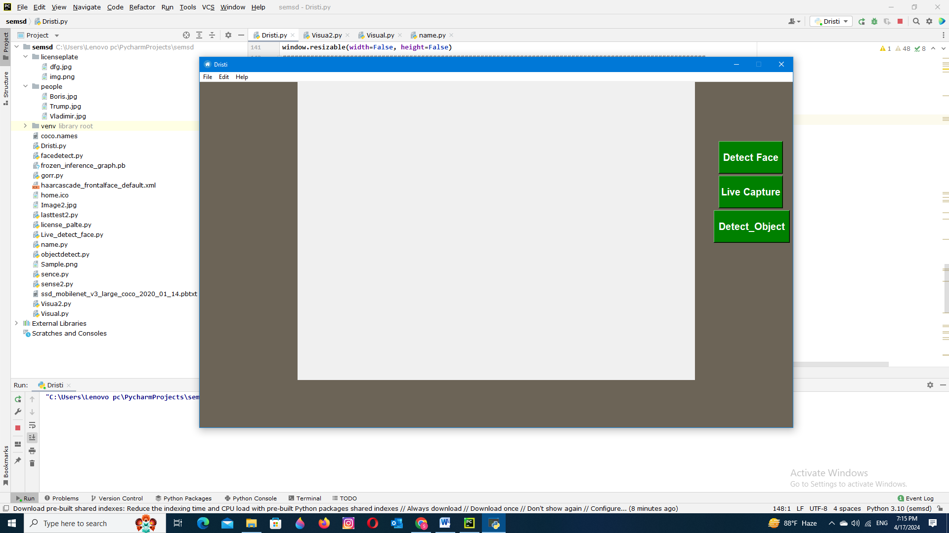
Images

Slide 16
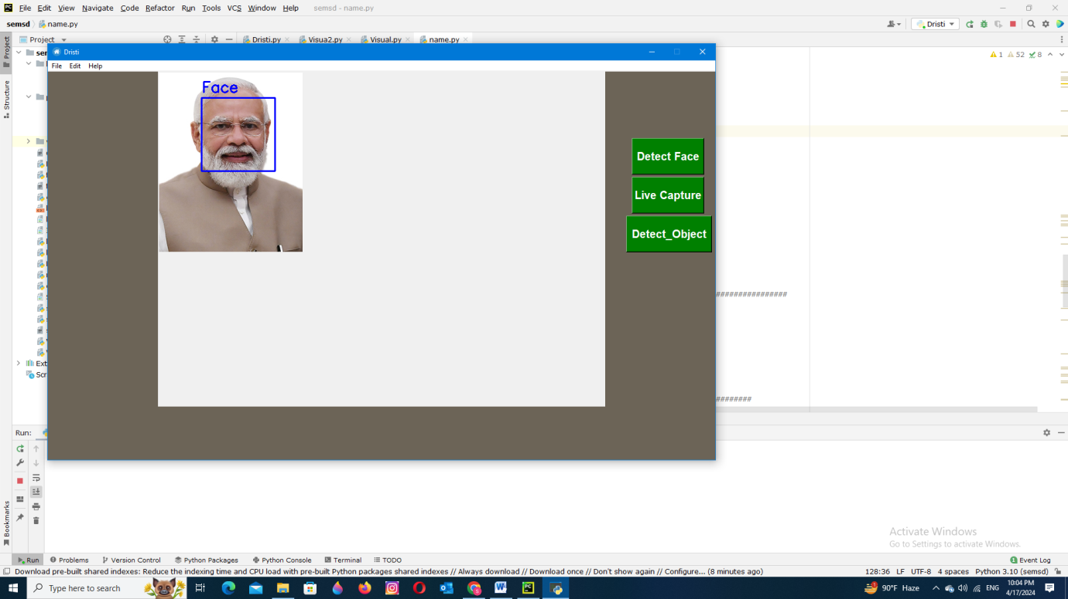

Slide 17
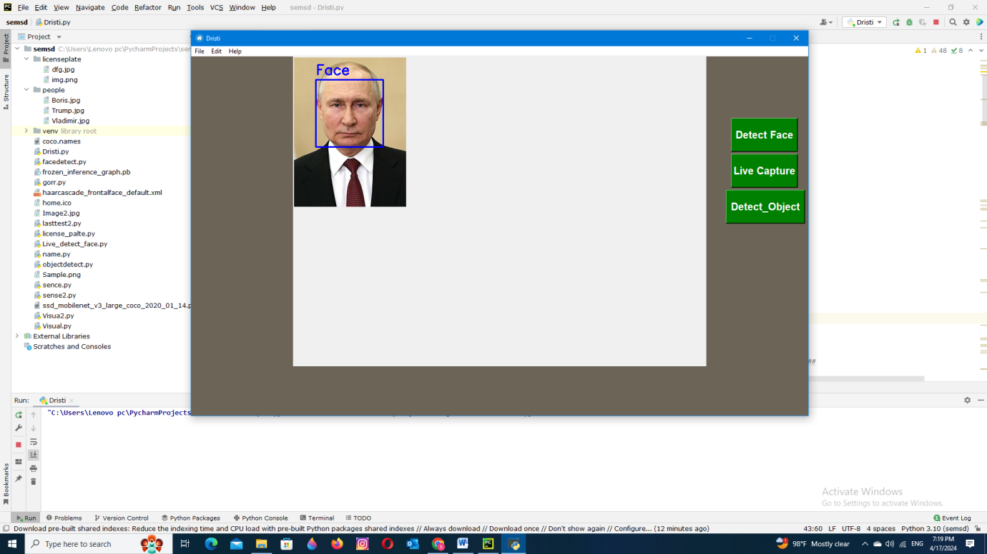

Slide 18
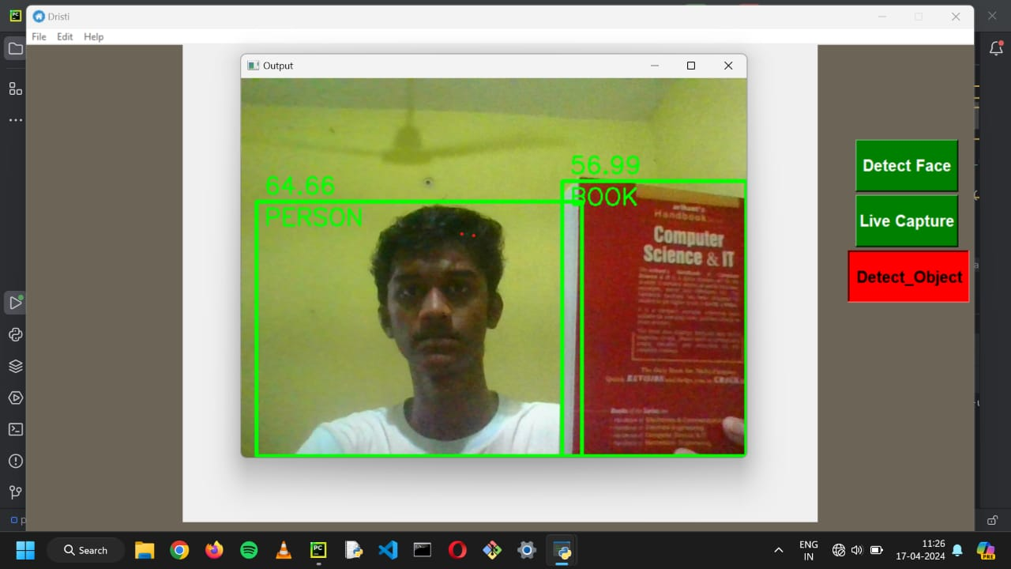

Slide 19
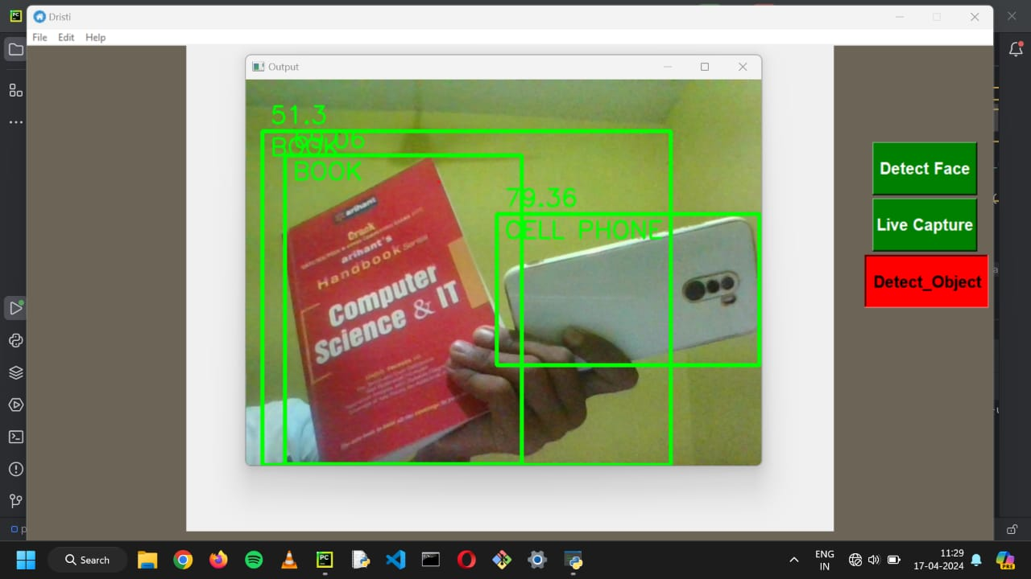

Slide 20
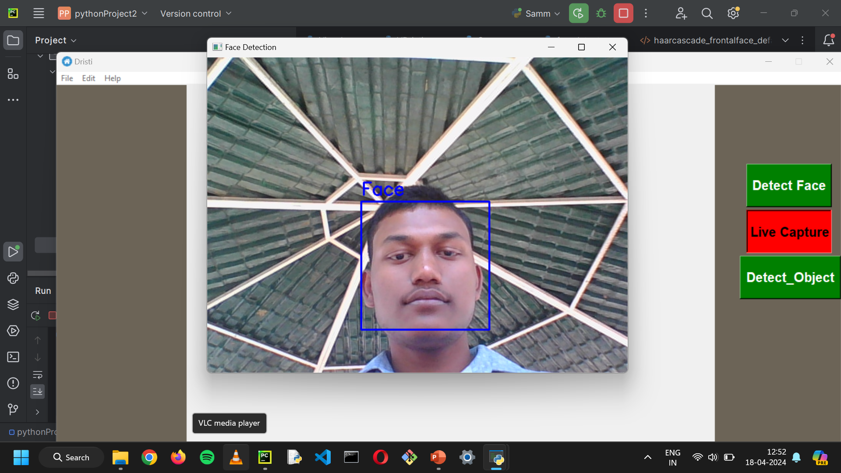

Slide 21
Conclusion
In conclusion, the implementation of face recognition and object detection using Python has proven to be a promising venture in the field of computer vision. Through this project, we have successfully developed algorithms capable of accurately identifying faces and detecting objects within images and videos. Leveraging the power of machine learning and deep learning techniques, we have achieved robust performance in recognizing faces and detecting various objects in diverse environments.
This project has numerous practical applications across various domains including surveillance, security systems, human-computer interaction, and augmented reality. The accuracy and efficiency of the developed algorithms make them suitable for real-world deployment, offering solutions to numerous challenges faced in these domains.

Slide 22
Thank You
If found interesting, may visits our Github repositories:
Biswamit: https://github.com/Biswal-Dev
Rajeev: https://github.com/Rajeev0214

